Slide 1
OakTruffle
Monitor de temperatura e umidade
Aperfeiçoamento no cultivo de trufas

Slide 2




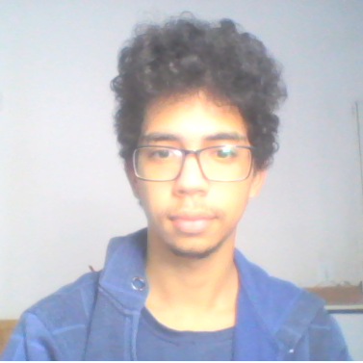

Equipe
Wesley Paternezi
Antonio Monteiro
Mateus Ferreira
Mateus Araujo
Gabriel Agra
Itallo David

Slide 3
Contextualização
^{O que são as trufas?}

Slide 4
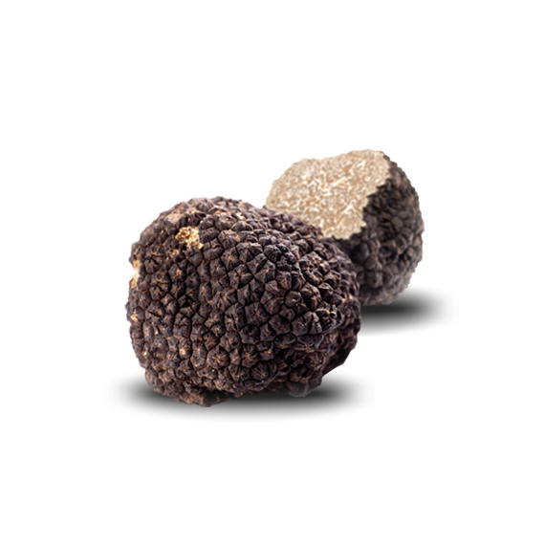
Contextualização
^{O que são as trufas?}

Slide 5
Justificativa
“As trufas correm o risco de desaparecer até o fim do século.”
- Ciência do meio ambiente – nov/2018

Slide 6
Processo de cultivo
Colheita das trufas
Criação nas raízes de árvores
Multiplicação das trufas
Encontrando os cogumelos
Cachorros e porcos para farejar
Transporte
Armazenamento
Temperatura: 21°C a 25°C
Umidade: 94% até 95% em relação a HR

Slide 7
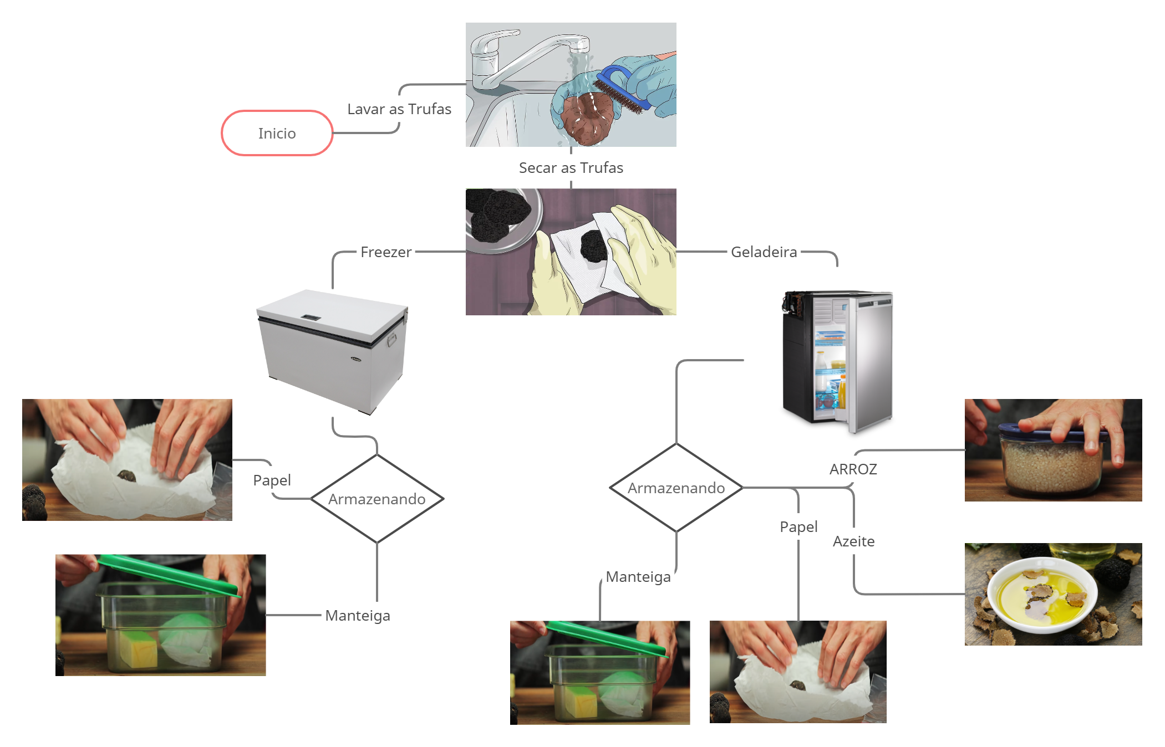
Processo de armazenamento

Slide 8
O que queremos fazer?
Melhorar o gerenciamento do cultivo de trufas para aumentar a produtividade e reduzir o risco das possíveis falhas do processo.

Slide 9
Nossa solução
Criação de um site de monitoramento
Sensores de temperatura e umidade
Monitoramento do solo e de recipientes
Análise estatística dos dados

Slide 10
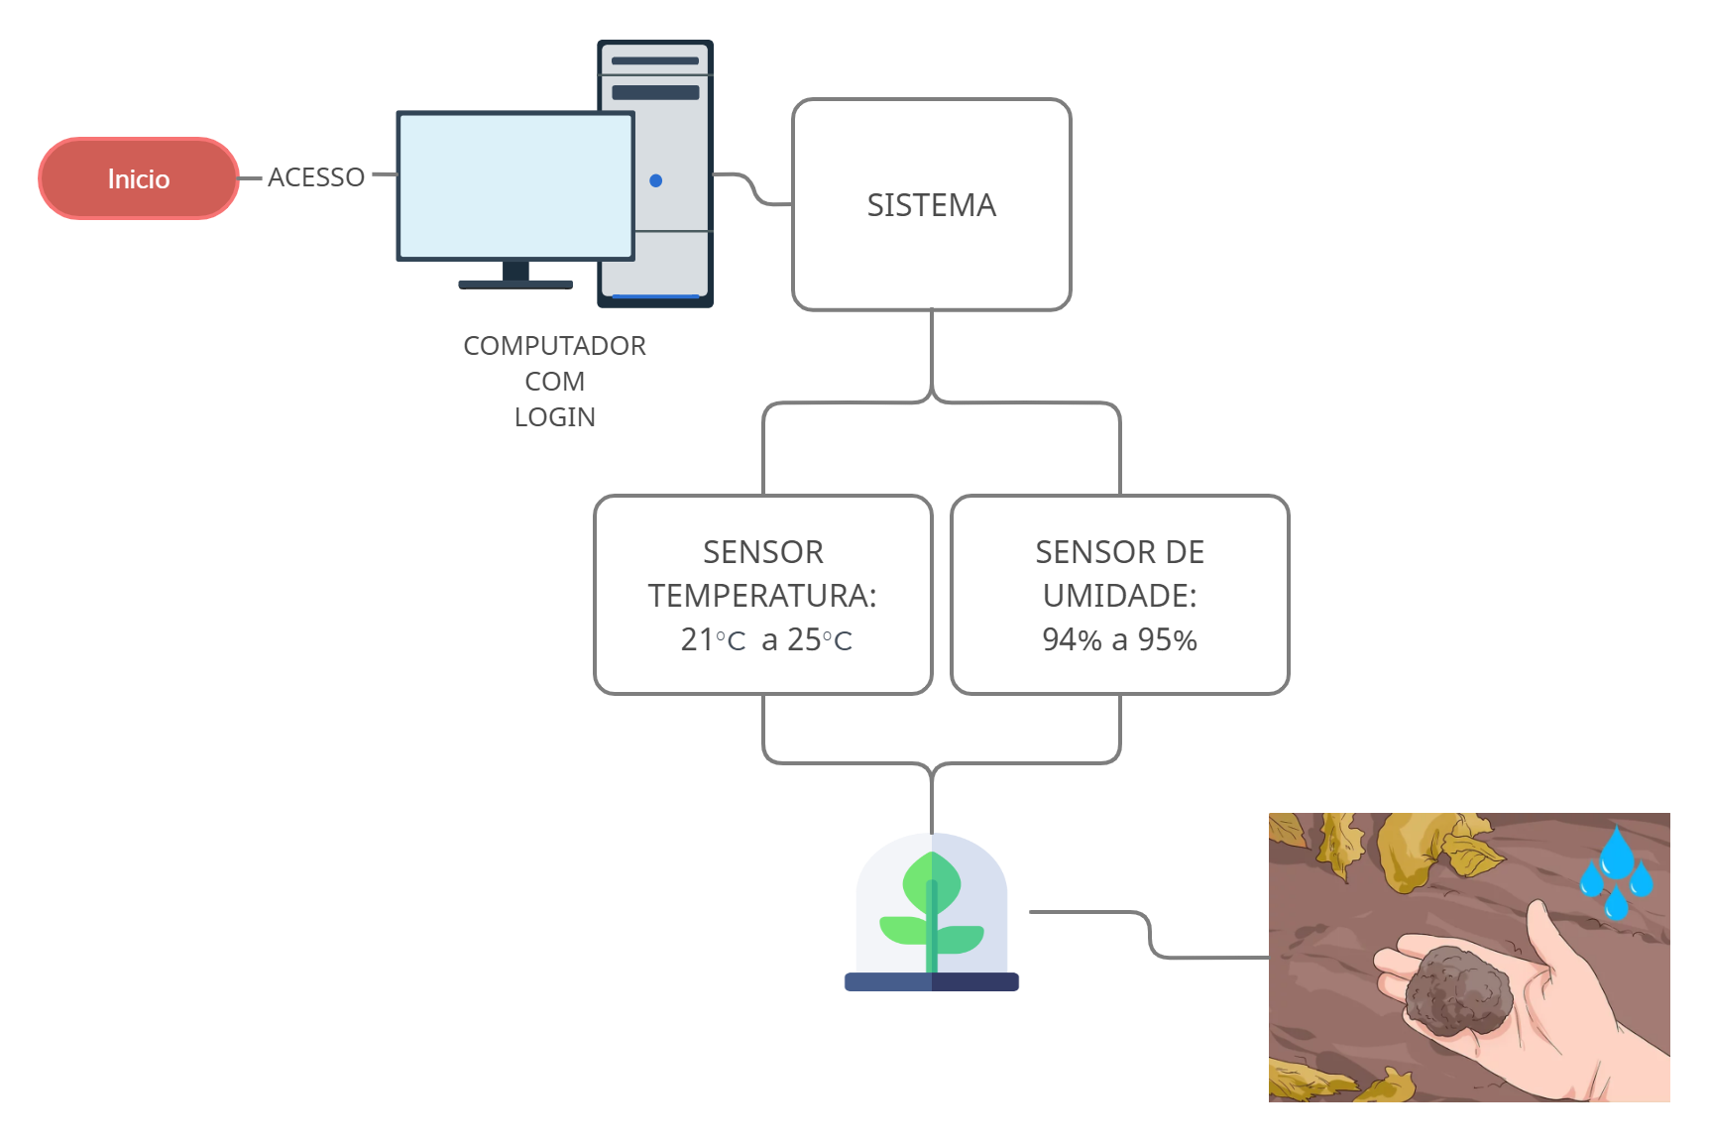
Desenho de solução

Slide 11
Nosso público alvo
Consumo Próprio
Amantes de culinária, que querem cultivar as suas próprias trufas
Comerciantes
Comerciantes que buscam aprimorar seu negócio, trazendo mais diversidade em seu comércio
Fazendeiros que já possuem plantações, mas querem aumentar o seu alcance e rentabilidade
Fazendeiros
Restaurantes que buscam aprimorar o seu cardápio com iguarias exóticas
Restaurantes

Slide 12
Obrigado

Slide 13
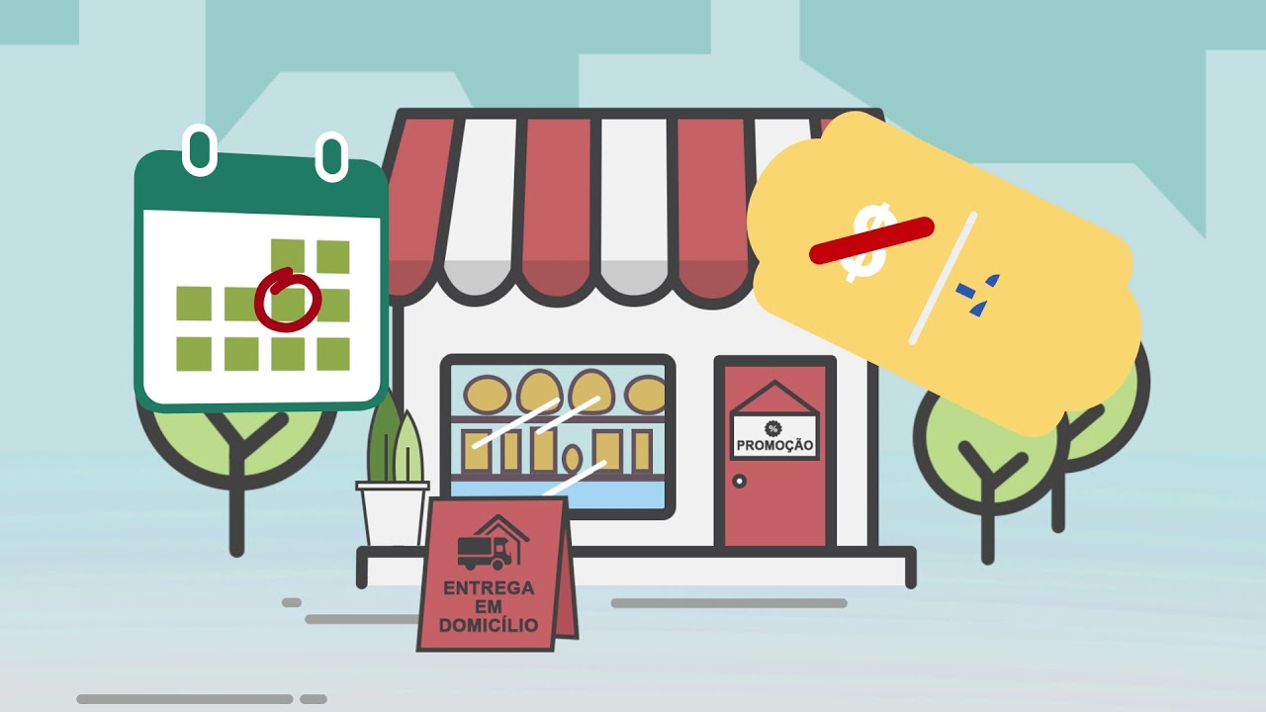
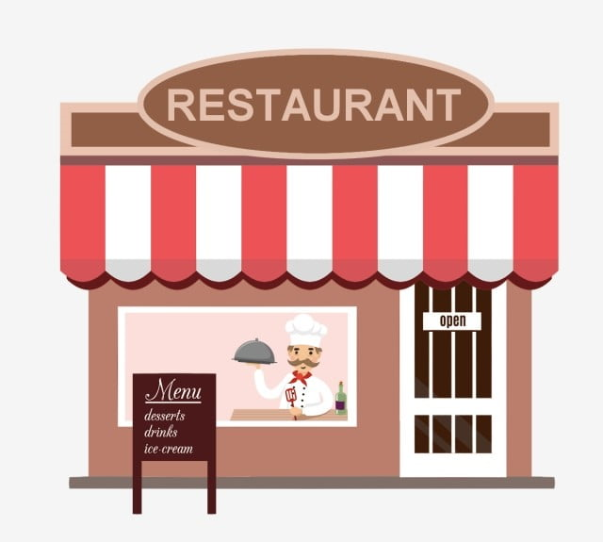
Público Alvo
Grandes Negócios
Comércios
Restaurantes
Pequenos Negócios

Slide 14

Desktop project
Show and explain your web, app or software projects using these gadget templates.

Slide 15
You can also split your content
White
Is the color of milk and fresh snow, the color produced by the combination of all the colors of the visible spectrum.
Black
Is the color of ebony and of outer space. It has been the symbolic color of elegance, solemnity and authority.

Slide 16
In two or three columns
Yellow
Is the color of gold, butter and ripe lemons. In the spectrum of visible light, yellow is found between green and orange.
Blue
Is the colour of the clear sky and the deep sea. It is located between violet and green on the optical spectrum.
Red
Is the color of blood, and because of this it has historically been associated with sacrifice, danger and courage.

Slide 17
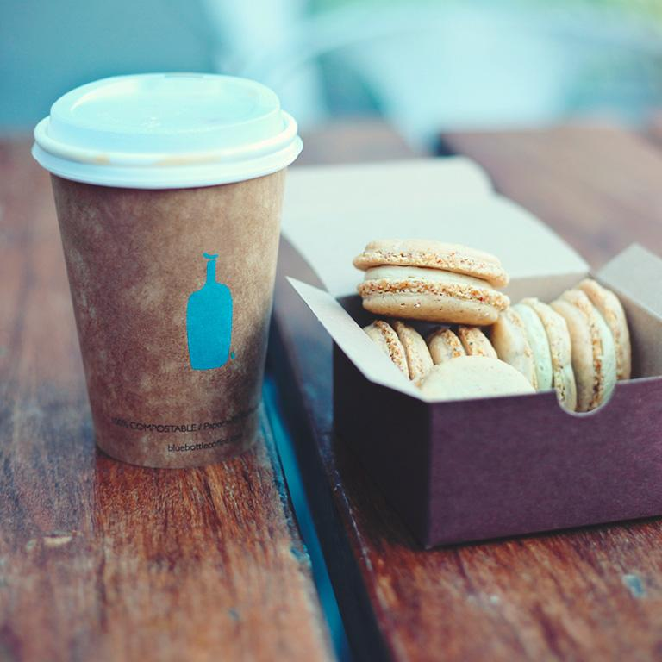
A picture is worth a thousand words
A complex idea can be conveyed with just a single still image, namely making it possible to absorb large amounts of data quickly.

Slide 18

Want big impact?
Use big image.

Slide 19
And tables to compare data
 | A | B | C
Yellow | 10 | 20 | 7
Blue | 30 | 15 | 10
Orange | 5 | 24 | 16

Slide 20
Maps
our office

Slide 21
89,526,124
Whoa! That’s a big number, aren’t you proud?

Slide 22
Quem é o nosso alvo
Restaurantes
Comércios
Consumo Próprio

Slide 23
89,526,124$
185,244 users
100%
That’s a lot of money
And a lot of users
Total success!

Slide 24
Our process is easy
first
second
last

Slide 25

Mobile project
Show and explain your web, app or software projects using these gadget templates.

Slide 26

Tablet project
Show and explain your web, app or software projects using these gadget templates.

Slide 27
Thanks!
Any questions?
You can find me at
@username
user@mail.me

Slide 28
Credits
Special thanks to all the people who made and released these awesome resources for free:
Presentation template by SlidesCarnival
Photographs by Unsplash

Slide 29
Presentation design
This presentations uses the following typographies and colors:
Titles & Body copy: Montserrat
You can download the fonts on this page:
https://www.fontsquirrel.com/fonts/montserrat
Grey #454f5b
Light grey #738498
Neon green #c7f464
Aqua #4ecdc4
You don’t need to keep this slide in your presentation. It’s only here to serve you as a design guide if you need to create new slides or download the fonts to edit the presentation in PowerPoint®

Slide 30
2. Extra Resources
For Business Plans, Marketing Plans, Project Proposals, Lessons, etc

Slide 31
Timeline
Blue is the colour of the clear sky and the deep sea
Red is the colour of danger and courage
Black is the color of ebony and of outer space
Yellow is the color of gold, butter and ripe lemons
White is the color of milk and fresh snow
Blue is the colour of the clear sky and the deep sea
JAN
FEB
MAR
APR
MAY
JUN
JUL
AUG
SEP
OCT
NOV
DEC
Yellow is the color of gold, butter and ripe lemons
White is the color of milk and fresh snow
Blue is the colour of the clear sky and the deep sea
Red is the colour of danger and courage
Black is the color of ebony and of outer space
Yellow is the color of gold, butter and ripe lemons

Slide 32
Roadmap
Blue is the colour of the clear sky and the deep sea
Red is the colour of danger and courage
Black is the color of ebony and of outer space
1
3
5
2
4
6
Yellow is the color of gold, butter and ripe lemons
White is the color of milk and fresh snow
Blue is the colour of the clear sky and the deep sea

Slide 33
Business Model Canvas
Key Partners
Insert your content
Key Activities
Insert your content
Value Propositions
Insert your content
Customer Relationships
Insert your content
Customer Segments
Insert your content
Key Resources
Insert your content
Channels
Insert your content
Cost Structure
Insert your content
Revenue Streams
Insert your content

Slide 34
Funnel
AWARENESS
Insert your content
DISCOVERY
Insert your content
EVALUATION
Insert your content
INTENT
Insert your content
PURCHASE
Insert your content
LOYALTY
Insert your content

Slide 35
Weekly Planner
 | SUNDAY | MONDAY | TUESDAY | WEDNESDAY | THURSDAY | FRIDAY | SATURDAY
09:00 - 09:45 | Task | Task | Task | Task | Task | Task | Task
10:00 - 10:45 | Task | Task | Task | Task | Task | Task | Task
11:00 - 11:45 | Task | Task | Task | Task | Task | Task | Task
12:00 - 13:15 | ✔ Free time | ✔ Free time | ✔ Free time | ✔ Free time | ✔ Free time | ✔ Free time | ✔ Free time
13:30 - 14:15 | Task | Task | Task | Task | Task | Task | Task
14:30 - 15:15 | Task | Task | Task | Task | Task | Task | Task
15:30 - 16:15 | Task | Task | Task | Task | Task | Task | Task

Slide 36
SlidesCarnival icons are editable shapes.
This means that you can:
Resize them without losing quality.
Change fill color and opacity.
Change line color, width and style.
Isn’t that nice? :)
Examples:

Slide 37
Diagrams and infographics

Slide 38
Now you can use any emoji as an icon!
And of course it resizes without losing quality and you can change the color.
How? Follow Google instructions https://twitter.com/googledocs/status/730087240156643328
✋👆👉👍👤👦👧👨👩👪💃🏃💑❤😂😉😋😒😭👶😸🐟🍒🍔💣📌📖🔨🎃🎈🎨🏈🏰🌏🔌🔑 and many more...

Slide 39

Free templates for all your presentation needs
For PowerPoint and Google Slides
100% free for personal or commercial use
Ready to use, professional and customizable
Blow your audience away with attractive visuals

